Slide 1

MVOTI TO UMZIMKULU CLASSIFICATION STUDY
Technical Working Group Meeting
Session 1: Approach to evaluate and compare scenarios as an aid to decision makers to recommend a scenario and Water Resource Class
3 October 2014
DWA CORPORATE IDENTITY
Presented by:
Johan Maree
Deputy Director: Media Production
12 December 2012

Slide 2
Session 1: Agenda
Recap and overview of the approach
Description of the scenarios
Rating method and results of the individual variables:
  Ecological
  EcoSystem services
  Economic indicator
  Employment indicator
Integrated assessment and overall ranking of scenarios.
Sensitivity analysis and synthesis of results.
Derivation of the Water Resource Class for each IUA.

Slide 3
MVOTI TO UMZIMKULU CLASSIFICATION STUDY
Session 1: Approach to evaluate and compare scenarios as an aid to decision makers to recommend a scenario and Water Resource Class
Recap and overview of the approach
DWA CORPORATE IDENTITY
Presented by:
Johan Maree
Deputy Director: Media Production
12 December 2012

Slide 4
Mvoti Study integrated steps
1: Delineate units of analysis and describe the status quo
2: Initiation of stakeholder process and catchment visioning
3: Quantify EWRs
7: Gazette class configuration
4: Identification and evaluation of scenarios within IWRM
6: Resource Quality Objectives (EcoSpecs & water quality (user))
5: Draft Management Classes
Scenario Evaluation, MC determination
Notes:
Where does it fit into the process.

Slide 5
What needs to be evaluated?
Degree of the ecological health defined by Ecological Categories of biophysical nodes (none-monetary)
Ecosystem Services (none-monetary)
Socio-Economic implications
  Monetary (GDP) and non-monetary (job count)

Slide 6
What are scenarios?
Scenarios, in context of water resource management and planning are plausible definitions (settings) of the factors (variables) that influence the water balance and water quality in a catchment and the system as a whole

Slide 7
How is it rated?
Ecological consequences are rated according to the degree that the Recommended Ecological Category is met. (REC is the top of the scale.)
Ecosystem Services, present state is “1.0” with relative rating for scenarios.
Economic Indicator, in general GDP or other relevant comparative monitory indicator.
Employment, number of jobs as affected by scenario.
Integrated rank, weighted scores of above 4 variables – two methods of ranking.

Slide 8
Why Multi-Criteria Analysis?
Method to compare alternatives where the outcomes (consequences) are in different numerical terms.
Ecological consequences is a relative rating while economy is in monetary terms and employment in numbers.
Multi-Criteria Analysis is appropriate in these circumstances.
Notes:
Allocation priority (principle) in the NWA provide for legal protection of the ecology: Why?

Slide 9
What are scenarios used for?
Different levels of water use and protection are evaluated with the aim to find a preferred balanced scenario.
Water Resource Classification is the process to evaluate and recommend what that balance scenario entails.

Slide 10
Catchment Analysis
Catchment Resource Availability
Ecological
Water Requirements
Socio-Economic
Water Requirements
Protection
Use
Management Class
(Decision)

Slide 11
Scenario Evaluation Process
Vision
Scenario Description
Assign attributes to EWR nodes
Water
Availability Analysis
Estimate Consequences
Rank and
optimise
Formulate Alternative Scenarios
Select Scenario Subset
Stakeholder Evaluation
Ecological
Ecosystem Services
Economical
Non-Ecological Water Quality
Evaluate against
Vision

Slide 12
Concept of Multi Criteria evaluation method
Ranked
SC for each reach / node
Ranked SC for IUA / system
For all
scenarios
Ecology
Weighting process
Score
Fish
Geom
Inverts
Phys, Chem
Rip veg
Degree of meeting REC
EGSA
Weighting process
Integrated Comparison (all 3 variables)
Score
Food, fuel
Regulating
Cultural
Relative to present
provisions
Economy
Weighting process
Score
GDP
Jobs
Household
Income
Relative to base
condition

Slide 13
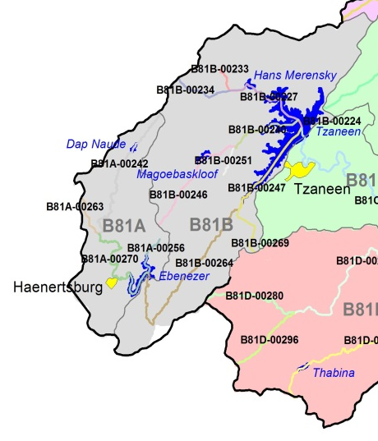
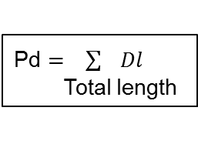
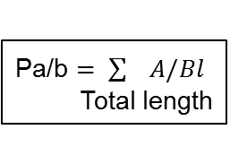
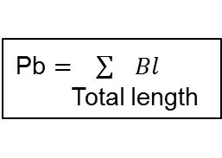
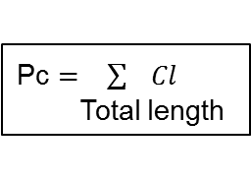
Deriving the Management Class
Ecological Categories for a Selected Scenario
(IUA 1)
River Reach | Length (km) | EC
B81A-00242 | 21.9 | C
B81A-00256 | 5.3 | D
B81A-00263 | 5.1 | D
B81A-00270 | 20.2 | C
B81B-00233 | 3.2 | C
B81B-00234 | 7.1 | C
B81B-00246 | 14.7 | C
B81B-00251 | 3.7 | D
B81B-00269 | 6.5 | B
B81B-00227 | 11.0 | D
B81B-00240 | 10.2 | C
B81B-00247 | 12.5 | C/D
EWR1 | 25.7 | C
Total length | 147.1
Pd $= \sum{Dl}$
Total length
Pc $= \sum{Cl}$
Total length
Pb $= \sum{Bl}$
Total length
Pa/b $= \sum{A/Bl}$
Total length
Management Class Criteria
 |  | % EC representation at units represented by biophysical nodes in an IUA |  |  |  |  | Prominent EC
 |  | ≥ A/B | ≥ B | ≥C | ≥ D | < D
Class I |  | 0 | 60 | 80 | 95 | 5 | A & B EC
Class II |  |  | 0 | 70 | 90 | 10 | C EC
Class III | Either |  |  | 0 | 80 | 20 | D EC
 | Or |  |  |  | 100
Management Class: I, II or III
EC - Ecological Category

Slide 14
Recommended Management Class Criteria Table
 |  | % EC representation at units represented by biophysical nodes in an IUA |  |  |  |  | Prominent Ecological Categories
 |  | ≥ A/B | ≥ B | ≥C | ≥ D | < D
Class I |  | 0 | 60 | 80 | 95 | 5 | A & B
Class II |  |  | 0 | 70 | 90 | 10 | C
Class III | Either |  |  | 0 | 80 | 20 | D
 | Or |  |  |  | 100
Unit Percentages:
Length of river in a given Ecological Category divided by the total river length in an IUA .

Slide 15
Multi Criteria Analysis Tool and Application
Spreadsheet based calculation tool
Bring together results - Four files:
    1. EcoSystem Services Ratings
    2. Ecology Ratings (EWR sites)
    3. Nodes database & ECs, river reach length, IUAs.
    4. Integration: (scenario rank, MCs for each IUA)
      Weights for: EWR site, node and river reach length.
      Variable weights.
      Sensitivity analysis (two ranking methods).
      Visualisation (“traffic diagrams”)

Slide 16
DWA CORPORATE IDENTITY
Presented by:
Johan Maree
Deputy Director: Media Production
12 December 2012
Description of Scenarios
Mvoti River System
uMkomazi River System

Slide 17
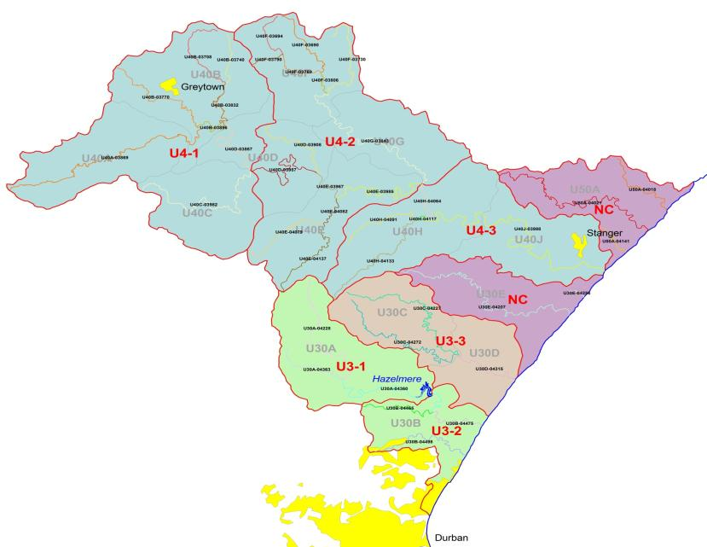
Mvoti River Catchment
Mvoti River Catchment
Storage Regulation Low
River Abstractions – reduced base flows
River management – restrict u/s to maintain supply to KwaDukuza (Stanger)
Future resource development
  IsiThundu Dam
  Imvutshane Dam

Slide 18
Water Requirements
Present Day Scenario defined from:
  Water Reconciliation Strategy Study for the KwaZulu-Natal Coastal Metropolitan Areas.
  DWA All Towns Strategies and the Water Reconciliation Strategy Study for the Kwazulu Natal Coastal Metropolitan Areas.
Ultimate Development Scenario:
  Increased water use and return flows for:
    Greytown – Groundwater abstraction, baseflow adjusted, return flows increased.
    KwaDukuza - Return flows increased (u/s estuary).
    Abstraction from the proposed Imvutshane Dam being planned by Umgeni Water, supply to Mapumulo and Maqumbi.
    Abstractions from the proposed Isithundu Dam for supply to North Coast and KwaDukuza areas.

Slide 19
Mvoti River Catchment
Scenarios | Scenario Variables
 | Ultimate Development Demands & Return Flows (2040) | EWR | Isithundu Dam | Imvutshane Dam
MV1 (PD) | No | No | No | No
MV3 | Yes | No | Yes | Yes
MV41 | Yes | REC total | Yes | Yes
MV42 | Yes | REC low | Yes | Yes
MV43 | Yes | REC low+ | Yes | Yes
Notes:
Recommended Ecological Category (REC) is to maintain the Present Ecological State (PES). Therefore no reduction in current water use activities needed to achieve REC.
Imvutshane Dam : Applied release recommendation in licence application from
“REC total” = Total EWR to meet REC requirements released from proposed Isithundu Dam.
“REC low”= Only release low flow component of REC.
“REC low+” = Release low flow component of REC and Total Flows for January, February and March.

Slide 20
Water available from future developments
Scenarios | EWR | Abstraction (million m³/annum)
 |  | IsiThundu Dam (Historical Firm Yield) | Imvutshane Dam
MV1 (PD) | No | Not applicable, no development in place.
MV3 | No | 34.9 | 4.38
MV41 | REC total | 8.1
MV42 | REC low | 15.2
MV43 | REC low+ | 13.8

Slide 21
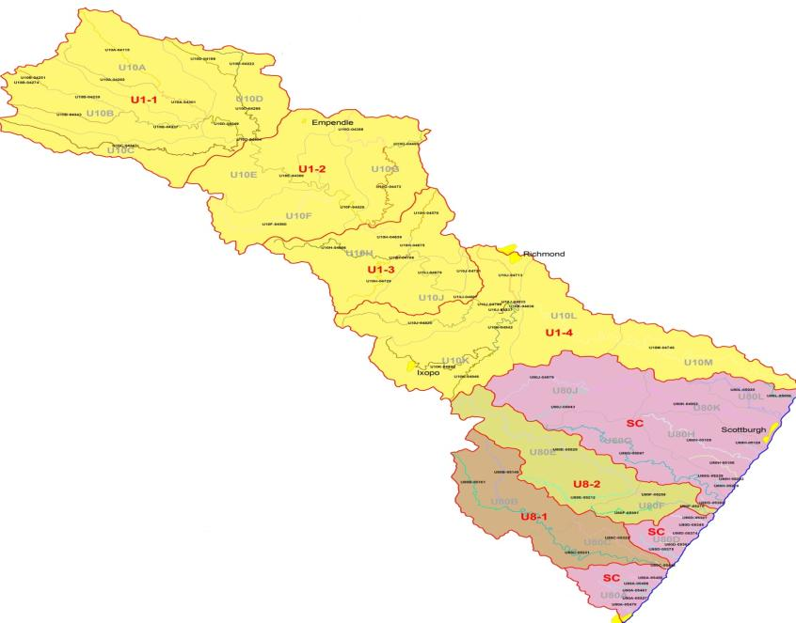
uMkhomazi River Catchment
Mzinto
None
EJ Smith
Sezela Dam
uMkhomazi River
Storage Regulation Low
Future resource development (uMkomazi Water Project-Smithfield Dam, Ngwadini Off-channel storage)

Slide 22
Water Requirements
Present Day Scenario defined from:
  Mkomazi Feasibility Study (2008 development level)
  Revised high resolution hydrology was developed.
Ultimate Development Scenario:
  Mkomazi Feasibility Study - 2040 scenario.
  Abstractions from Smithfield and Ngwadini off-channel storage dams
Water Use Sector (In-catchment) | Year
 | 2008 | 2040
Afforestation | 61.36 | 72.71
Invasive Alien Plants | 6.37 | 6.37
Irrigation | 37.70 | 51.69
Stock water | 2.86 | 3.03
Urban/Industrial | 53.00 | 57.44
Total: | 161.29 | 191.24
(Values in million m³/annum)

Slide 23
uMkhomazi River (1 of 2)
Scenarios (MK) | Scenario Variables
 | Ultimate Development (2040) | EWR |  | Smithfield Dam | Ngwadini OCD
1 | No | No |  | No | No
2 | Yes | No |  | Yes | Yes *
21 | Yes | REC tot | (EWR 2) | Yes | Yes *
22 | Yes | REC low | (EWR 2) | Yes | Yes *
23 | Yes | REC low+ | (EWR 2) | Yes | Yes *
31 | Yes | REC tot | (EWR 3) | Yes | Yes *
32 | Yes | REC low | (EWR 3) | Yes | Yes *
33 | Yes | REC low+ | (EWR 3) | Yes | Yes *
* River abstraction to Ngwadini Dam not supported by Smithfield Dam, abstract HFY.
“(EWR 2)” = Releases made from Smithfield Dam based on EWR site 2 requirements.
“(EWR 3)” = Releases made from Smithfield Dam based on EWR site 3 requirements.
Scenario 2x, 3x and 4x, releases are made for d/s users from Smithfield Dam with 10% losses.
Mainstream irrigation maintained a present reliability of supply.
Notes:
Ecological consequences were evaluated at all three EWR sites.

Slide 24
uMkhomazi River (2 of 2)
Scenarios (MK) | Scenario Variables
 | Ultimate Development (2040) | EWR | Smithfield Dam | Ngwadini OCD
4 | Yes | No | Yes | Yes (with support)
41 | Yes | REC tot (EWR 2) | Yes | Yes (with support)
42 | Yes | REC low (EWR 2) | Yes | Yes (with support)
Notes:
“(EWR 2)” = Releases made from Smithfield Dam based on EWR site 2 requirements.
“with support” = Ngwadini Dam supported from Smithfield Dam to supply 54.8 million m³/a.
Scenario 4x, EWR requirements maintained in river reach d/s of offtake to Ngwadini Dam.
General notes:
Sappi SAICCOR is supplied with EWR releases.
All scenarios maintain a minimum flow of 1 m³/s into the estuary.
“REC total” = Total EWR to meet REC requirements released from proposed IsiThundu Dam.
“REC low”= Only release low flow component of REC.
“REC low+” = Release low flow component of REC and Total Flows for January, February and March.

Slide 25
Water available from future developments
Scenarios (MK) | Scenario Variables
 | Ultimate Development (2040) | EWR |  | Smithfield Dam | Ngwadini Off-Channel Dam | Total
1 | No | No
2 | Yes | No |  | 196.0 | 12.0 | 208.0
21 | Yes | REC tot | (EWR 2) | 142.2 | 8.0 | 150.2
22 | Yes | REC low | (EWR 2) | 150.6 | 8.0 | 158.6
23 | Yes | REC low+ | (EWR 2) | 150.6 | 8.0 | 158.6
31 | Yes | REC tot | (EWR 3) | 150.1 | 6.0 | 156.1
32 | Yes | REC low | (EWR 3) | 161.0 | 6.6 | 167.6
33 | Yes | REC low+ | (EWR 3) | 161.0 | 6.6 | 167.6
4 | Yes | No |  | 142.5 | 54.8 | 197.3
41 | Yes | REC tot | (EWR 2) | 84.1 | 54.8 | 138.9
42 | Yes | REC low | (EWR 2) | 92.5 | 54.8 | 147.3
Notes:
Ecological consequences were evaluated at all three EWR sites.

Slide 26
DWA CORPORATE IDENTITY
Presented by:
Johan Maree
Deputy Director: Media Production
12 December 2012
End Recap, Overview and Scenarios

Slide 27
DWA CORPORATE IDENTITY
Presented by:
Johan Maree
Deputy Director: Media Production
12 December 2012
Mvoti River System
Integrated assessment and overall ranking of scenarios.
Sensitivity analysis and synthesis of results.
Derivation of the Water Resource Class for each IUA.

Slide 28
Integrated assessment and overall ranking(Score = weight x rating) of scenarios
Ecological Score : Example for EWR site 2
Node | Weights: |  | Weight Normalisation: |  |  | Scenario Rating: |  |  |  | Scenario Score:
 | Importance | Length | Importance | Length | Combined
 |  | (km) | 1 | 0 |  | 3 | 41 | 42 | 43 | 3 | 41 | 42 | 43
EWR2 | 423 | 8.3 | 0.41 | 0.01 | 0.41 | 0.78 | 1.00 | 0.96 | 0.96 | 0.32 | 0.41 | 0.40 | 0.40
27 Biophysical Nodes including 2 EWR sites
Scores summed for all nodes for each scenario then applied in integrated calculation with all four variables.

Slide 29
Variable Scores & Weights
Variables | Scenarios
 | 3 | 41 | 42 | 43
Ecological Status | 0.843 | 0.969 | 0.938 | 0.936
Ecosystem Services | 1.014 | 1 | 1.077 | 1.074
Economic Indicator (GDP) (R Millions) | 281 37 | 28 137 | 22 737 | 21 838
Employment | 17 052 | 6 619 | 10 821 | 10 091
Variables | Weights
Ecological Status | 0.5
Ecosystem Services | 0.05
Economic Indicator | 0.2
Employment | 0.25
50% Ecology
50% Socio-Economic

Slide 30
Visualisation of Variables Scores

Slide 31
Overall Ranking (Two Rank Methods)
Method | Scenarios
 | 3 | 41 | 42 | 43
Overall Score (Rank Order method) | 2.40 | 2.40 | 3.05 | 2.05
Rank (1 = best, 4 = worse) | 3 | 2 | 1 | 4
Overall Score (Normalisation Method) | 0.459 | 0.500 | 0.641 | 0.596
Rank (1 = best, 4 = worse) | 4 | 3 | 1 | 2

Slide 32
Sensitivity analysis and synthesis of results
Weights |  |  |  |  |  | Rank Position of Scenario (Normalisation Ranking Method)
Alternative | Ecology | EcoSystem Services | GDP | Jobs |  | 3 | 41 | 42 | 43
1 | 0.50 | 0.05 | 0.20 | 0.25 |  | 3 | 2 | 1 | 4
2 | 0.50 | 0.10 | 0.20 | 0.20 |  | 3 | 2 | 1 | 4
3 | 0.50 | 0.15 | 0.15 | 0.20 |  | 3 | 2 | 1 | 4
4 | 0.50 | 0.05 | 0.15 | 0.30 |  | 3 | 2 | 1 | 4
5 | 0.50 | 0.05 | 0.30 | 0.15 |  | 3 | 2 | 1 | 4
6 | 0.25 | 0.25 | 0.25 | 0.25 |  | 2 | 4 | 1 | 3
7 | 0.20 | 0.10 | 0.40 | 0.30 |  | 1 | 4 | 2 | 3
8 | 0.15 | 0.10 | 0.45 | 0.30 |  | 1 | 4 | 2 | 3
Rank: 1 = best, 4 = worse.

Slide 33
Mvoti River Catchment
Scenarios | Scenario Variables
 | Ultimate Development Demands & Return Flows (2040) | EWR | Isithundu Dam | Imvutshane Dam
MV1 (PD) | No | No | No | No
MV3 | Yes | No | Yes | Yes
MV41 | Yes | REC total | Yes | Yes
MV42 | Yes | REC low | Yes | Yes
MV43 | Yes | REC low+ | Yes | Yes
Discussion:
Scenario 42 is the best ranked scenarios, Scenario 43 is however close and has the benefit of total flows in January, February and March. It may be possible through operational optimisation to improve on Scenario 43.
Comments?

Slide 34
Derivation of the Water Resource Class for each IUA
Recommended Management Class Criteria Table
 |  | % EC representation at units represented by biophysical nodes in an IUA |  |  |  |  | Prominent Ecological Categories
 |  | ≥ A/B | ≥ B | ≥C | ≥ D | < D
Class I |  | 0 | 60 | 80 | 95 | 5 | A & B
Class II |  |  | 0 | 70 | 90 | 10 | C
Class III | Either |  |  | 0 | 80 | 20 | D
 | Or |  |  |  | 100
Unit Percentages:
Length of river in a given Ecological Category divided by the total river length in an IUA .
Notes:
Se hoekom ons lengte van rivier gebruik
Gee voorbeel van iets wat in 'n A is maar net 10 % van lengte is, en res van rivier is in C. Etc - as jy net 2 nodes gehad het dan is dit 50/50.
Maar nou is 90% 'n C so dit behoort klas 2 te wees.
En maak seker jy noem dat agv catchment config, beteken dit nie dat die A wegval nie.

Slide 35
Resulting IUA Management Classes for all scenarios
Integrated Unit of Analysis | Scenarios and Management Class
 | PES | REC | 3 | 41 | 42 | 43
U4-1 | II | II | II | II | II | II
U4-2 | II | I | II | II | II | II
U4-3 | II | I | III | II | II | II
U4-4 | III | II | XXX | III | III | III
“XXX” – Scenario did not achieve Class III criteria

Slide 36
Ecological Categories for all Scenarios
Nodes | River | IUA | River Length (km) | Ecological Category for Scenarios
 |  |  |  | 3 | 41 | 42 | 43
U40A-03869 | Mvoti | U4-1 | 54.5 | B/C | B/C | B/C | B/C
U40B-03708 | Intinda | U4-1 | 18.7 | C | C | C | C
U40B-03740 | Mvozana | U4-1 | 11.0 | C | C | C | C
Mv_I_EWR1 | Heinespruit | U4-1 | 27.8 | C | C | C | C
U40B-03832 | Mvozana | U4-1 | 16.7 | C/D | C/D | C/D | C/D
U40B-03896 | Mvoti | U4-1 | 9.7 | C | C | C | C
U40C-03982 | Khamanzi | U4-1 | 40.2 | B/C | B/C | B/C | B/C
U40D-03867 | Mvoti | U4-1 | 18.6 | B/C | B/C | B/C | B/C
U40D-03908 | Mtize | U4-2 | 18.9 | B | B | B | B
U40D-03957 | Mvoti | U4-2 | 27.7 | B | B | B | B
U40E-03967 | Mvoti | U4-2 | 8.4 | D | C | C | C
U40E-03985 | Mvoti | U4-2 | 27.7 | D | C | C | C
U40E-04079 | Faye | U4-2 | 21.2 | B | B | B | B
U40E-04082 | Sikoto | U4-2 | 8.0 | B | B | B | B
U40E-04137 | Sikoto | U4-2 | 23.1 | B | B | B | B
U40F-03690 | Potspruit | U4-2 | 17.3 | C | C | C | C
U40F-03694 | Hlimbitwa | U4-2 | 11.0 | C | C | C | C
U40F-03730 | Cubhu | U4-2 | 24.3 | C | C | C | C
U40F-03769 | Hlimbitwa | U4-2 | 13.3 | C | C | C | C
U40F-03790 | Nseleni | U4-2 | 5.9 | B/C | B/C | B/C | B/C
U40F-03806 | Hlimbitwa | U4-2 | 6.1 | B | B | B | B
U40G-03843 | Hlimbitwa | U4-2 | 42.5 | B | B | B | B
Mv_I_EWR2 | Mvoti | U4-3 | 8.3 | D | C | C | C
U40H-04091 | Pambela | U4-3 | 17.5 | B/C | B/C | B/C | B/C
U40H-04117 | Nsuze | U4-3 | 2.7 | B/C | B/C | B/C | B/C
U40H-04133 | Nsuze | U4-3 | 27.9 | B/C | B/C | B/C | B/C
U40J-03998 | Mvoti | U4-3 | 54.6 | D | C | C | C
Mv_Est | Mvoti_Est | U4-4 |  | E | D | D | D

Slide 37
DWA CORPORATE IDENTITY
Presented by:
Johan Maree
Deputy Director: Media Production
12 December 2012
uMkhomazi River System
Integrated assessment and overall ranking of scenarios.
Sensitivity analysis and synthesis of results.
Derivation of the Water Resource Class for each IUA.

Slide 38
Variable Scores & Weights
Variables | Scenarios
 | 2 | 21 | 22 | 23 | 31 | 32 | 33 | 4 | 41 | 42
Ecological Status | 0.67 | 0.90 | 0.85 | 0.85 | 0.87 | 0.81 | 0.81 | 0.69 | 0.90 | 0.85
Ecosystem Services | 0.93 | 1.00 | 0.98 | 0.98 | 0.99 | 0.97 | 0.97 | 0.95 | 1.00 | 0.99
Economic Indicator (GDP) (R Billions) | 307.1 | 297.6 | 298.9 | 298.9 | 294.2 | 297.34 | 297.2 | 302.8 | 281.7 | 286.6
Employment (x1000) | 276 | 260 | 264 | 264 | 263 | 267 | 267 | 261 | 210 | 221
Variables | Weights
Ecological Status | 0.5
Ecosystem Services | 0.05
Economic Indicator | 0.2
Employment | 0.25
50% Ecology
50% Socio-Economic

Slide 39
Visualisation of Variables Scores

Slide 40
Overall Ranking (Two Rank Methods)
Method | Scenarios
 | 2 | 21 | 22 | 23 | 31 | 32 | 33 | 4 | 41 | 42
Overall Score (Rank Order method) | 5.05 | 7.45 | 6.15 | 6.15 | 6.25 | 4.95 | 4.95 | 3.9 | 5.4 | 4.75
Rank (1 = best, 10 = worse) | 6 | 1 | 3.5 | 3.5 | 2 | 7.5 | 7.5 | 10 | 5 | 9
Overall Score (Normalisation Method) | 0.45 | 0.87 | 0.77 | 0.77 | 0.78 | 0.68 | 0.68 | 0.43 | 0.54 | 0.51
Rank (1 = best, 10 = worse) | 9 | 1 | 3.5 | 3.5 | 2 | 5.5 | 5.5 | 10 | 7 | 8

Slide 41
Sensitivity analysis and synthesis of results
Weights |  |  |  |  |  | Rank Position of Scenario (Normalisation Ranking Method)
Alternative | Ecology | EcoSystem Services | GDP | Jobs |  | 2 | 21 | 22 | 23 | 31 | 32 | 33 | 4 | 41 | 42
1 | 0.50 | 0.05 | 0.20 | 0.25 |  | 6.0 | 1.0 | 3.5 | 3.5 | 2.0 | 7.5 | 7.5 | 10.0 | 5.0 | 9.0
2 | 0.50 | 0.10 | 0.20 | 0.20 |  | 9.0 | 1.0 | 3.5 | 3.5 | 2.0 | 7.5 | 7.5 | 10.0 | 5.0 | 6.0
3 | 0.50 | 0.15 | 0.15 | 0.20 |  | 9.0 | 1.0 | 4.5 | 4.5 | 2.0 | 7.5 | 7.5 | 10.0 | 3.0 | 6.0
4 | 0.50 | 0.05 | 0.15 | 0.30 |  | 8.0 | 1.0 | 3.5 | 3.5 | 2.0 | 6.5 | 6.5 | 10.0 | 5.0 | 9.0
5 | 0.50 | 0.05 | 0.30 | 0.15 |  | 6.0 | 1.0 | 2.5 | 2.5 | 4.0 | 8.5 | 8.5 | 10.0 | 5.0 | 7.0
6 | 0.25 | 0.25 | 0.25 | 0.25 |  | 5.0 | 1.0 | 2.5 | 2.5 | 4.0 | 7.0 | 7.0 | 10.0 | 7.0 | 9.0
7 | 0.20 | 0.10 | 0.40 | 0.30 |  | 1.0 | 4.0 | 2.5 | 2.5 | 8.0 | 6.0 | 6.0 | 6.0 | 10.0 | 9.0
8 | 0.15 | 0.10 | 0.45 | 0.30 |  | 1.0 | 4.0 | 2.5 | 2.5 | 8.0 | 6.5 | 6.5 | 5.0 | 10.0 | 9.0
Rank: 1 = best, 10 = worse.

Slide 42
uMkhomazi River - Selection
Scenarios (MK) | Scenario Variables
 | Ultimate Development (2040) | EWR |  | Smithfield Dam | Ngwadini OCD
1 | No | No |  | No | No
2 | Yes | No |  | Yes | Yes *
21 | Yes | REC tot | (EWR 2) | Yes | Yes *
22 | Yes | REC low | (EWR 2) | Yes | Yes *
23 | Yes | REC low+ | (EWR 2) | Yes | Yes *
31 | Yes | REC tot | (EWR 3) | Yes | Yes *
32 | Yes | REC low | (EWR 3) | Yes | Yes *
33 | Yes | REC low+ | (EWR 3) | Yes | Yes *
4 | Yes | No | Yes | Yes (with support)
41 | Yes | REC tot (EWR 2) | Yes | Yes (with support)
42 | Yes | REC low (EWR 2) | Yes | Yes (with support)
Notes:
Ecological consequences were evaluated at all three EWR sites.

Slide 43
Derivation of the Water Resource Class for each IUA
Recommended Management Class Criteria Table
 |  | % EC representation at units represented by biophysical nodes in an IUA |  |  |  |  | Prominent Ecological Categories
 |  | ≥ A/B | ≥ B | ≥C | ≥ D | < D
Class I |  | 0 | 60 | 80 | 95 | 5 | A & B
Class II |  |  | 0 | 70 | 90 | 10 | C
Class III | Either |  |  | 0 | 80 | 20 | D
 | Or |  |  |  | 100
Unit Percentages:
Length of river in a given Ecological Category divided by the total river length in an IUA .
Notes:
Se hoekom ons lengte van rivier gebruik
Gee voorbeel van iets wat in 'n A is maar net 10 % van lengte is, en res van rivier is in C. Etc - as jy net 2 nodes gehad het dan is dit 50/50.
Maar nou is 90% 'n C so dit behoort klas 2 te wees.
En maak seker jy noem dat agv catchment config, beteken dit nie dat die A wegval nie.

Slide 44
Resulting IUA Management Classes for all scenarios
Integrated Unit of Analysis | Scenarios and Management Class
 | PES | REC | 2 | 21 | 22 | 23 | 31 | 32 | 33 | 4 | 41 | 42
U1-1 | I | I | I | I | I | I | I | I | I | I | I | I
U1-2 | II | II | III | II | II | II | II | II | II | III | II | II
U1-3 | II | I | II | II | II | II | II | II | II | II | II | II
U1-4 | II | II | III | II | III | III | II | II | II | III | II | III
U1-5 | II | I | XXX | III | III | III | III | III | III | III | III | III
“XXX” – Scenario did not achieve Class III criteria

Slide 45
Ecological Categories for top ranked scenario
Nodes | River | IUA | Ecological Category:
 |  |  | Sc 21
U10A-04115 | Lotheni | U1-1 | A/B
U10A-04202 | Nhlathimbe | U1-1 | B
U10A-04301 | Lotheni | U1-1 | B
U10B-04239 | Mkomazi | U1-1 | B
U10B-04251 | Mkomazi | U1-1 | A
U10B-04274 | Nhlangeni | U1-1 | A
U10B-04337 | Mkomazi | U1-1 | C
U10B-04343 | Mqatsheni | U1-1 | B
U10C-04347 | Mkhomazana | U1-1 | B
U10D-04199 | Nzinga | U1-1 | A
U10D-04222 | Rooidraai | U1-1 | B
U10D-04298 | Nzinga | U1-1 | B/C
U10D-04349 | Mkomazi | U1-1 | C
U10D-04434 | Mkomazi | U1-1 | C
Mk_I_EWR1 | Mkomazi | U1-2 | C
U10F-04528 | Mkomazi | U1-2 | C
U10F-04560 | Luhane | U1-2 | B/C
U10G-04388 | Elands | U1-2 | C
U10G-04405 |  | U1-2 | C
U10G-04473 | Elands | U1-2 | C
U10H-04576 | Tholeni | U1-3 | B
Nodes | River | IUA | Ecological Category:
 |  |  | Sc 21
U10H-04576 U10H-04638 | Tholeni Mkomazi | U1-3 U1-3 | B B
U10H-04666 | Ngudwini | U1-3 | B/C
U10H-04675 | Mkomazi | U1-3 | B
U10H-04708 | Ngudwini | U1-3 | B
U10H-04729 | Mzalanyoni | U1-3 | C
Mk_I_EWR2 | Mkomazi | U1-3 | B
U10J-04721 | Pateni | U1-3 | B
U10J-04807 | Mkomazi | U1-3 | B
U10J-04713 | Mkobeni | U1-4 | C
U10J-04799 | Mkomazi | U1-4 | B
U10J-04820 | Lufafa | U1-4 | B/C
U10J-04833 | Mkomazi | U1-4 | B
U10J-04837 |  | U1-4 | A/B
U10K-04838 | Mkomazi | U1-4 | C
U10K-04842 | Nhlavini | U1-4 | B
U10K-04899 | Xobho | U1-4 | C/D
U10K-04946 | Nhlavini | U1-4 | B/C
Mk_I_EWR3 | Mkomazi | U1-4 | C
MK_Est | Mkomazi_Est | U1-5 | C/D

Slide 46
DWA CORPORATE IDENTITY
Presented by:
Johan Maree
Deputy Director: Media Production
12 December 2012
Thank You

